Slide 1
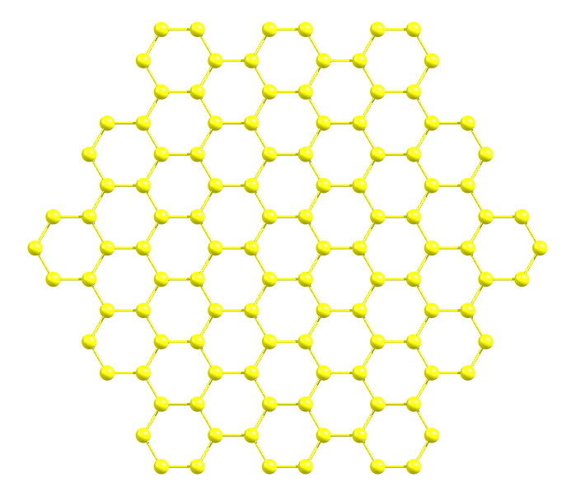
(0,-2)
(1,-1)
(2,0)
(-1,-2)
(0,-1)
(1,0)
(2,1)
(-2,-2)
(-1,-1)
(0,0)
(1,1)
(2,2)
(0,1)
(-2,-1)
(-1,0)
(0,1)
(1,2)
(-2,0)
(-1,1)
(0,2)

